Slide 1
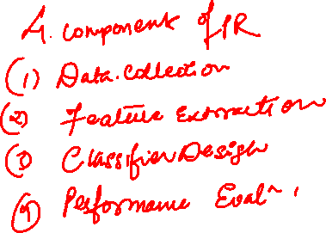
Pattern Recognition
Module 1

Slide 2
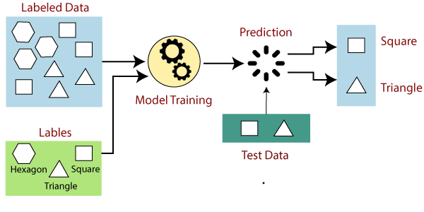
Supervised Learning

Slide 3
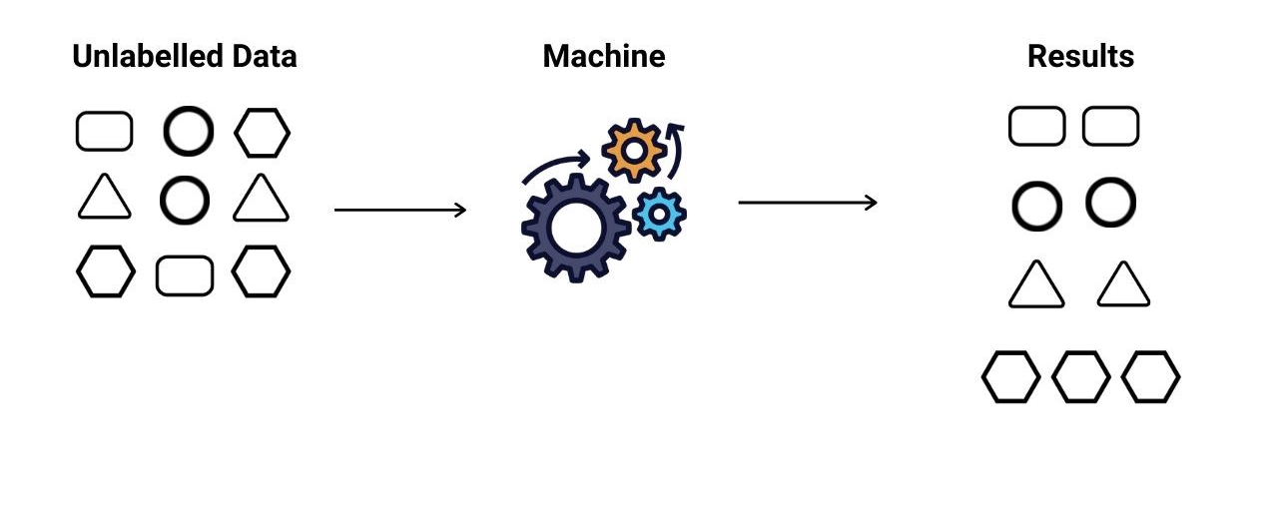
Unsupervised Learning

Slide 4
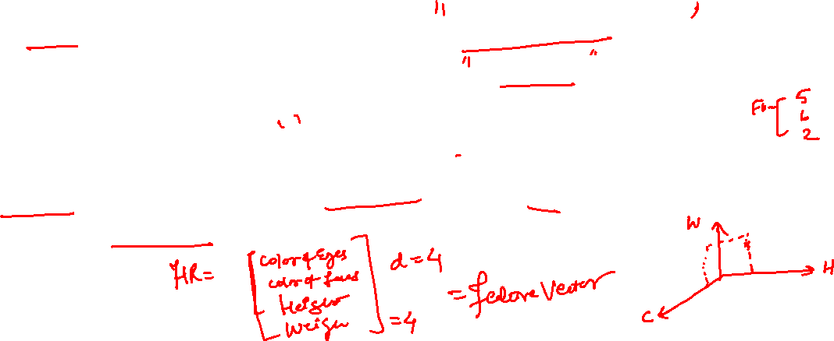
Features
Pattern recognition system should recognize familiar patterns quickly and accurate
Feature can be defined as any distinctive aspect, quality or characteristic which, may be symbolic (i.e., color) or numeric (i.e., height).
The combination of d features is represented as a d-dimensional column vector called a feature vector. The d-dimensional space defined by the feature vector is called feature space.

Slide 5
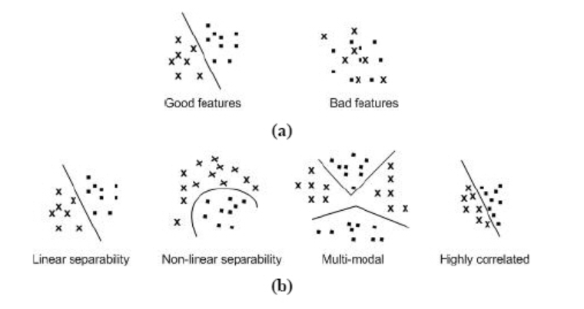
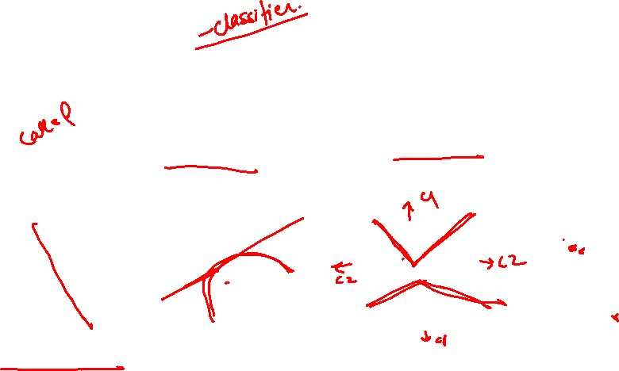
Features

Slide 6

Features
Often the features are obtained from Shape and Region
Boundary:
The shape of the object
Region:
Color
Area/perimeter covered
Texture

Slide 7
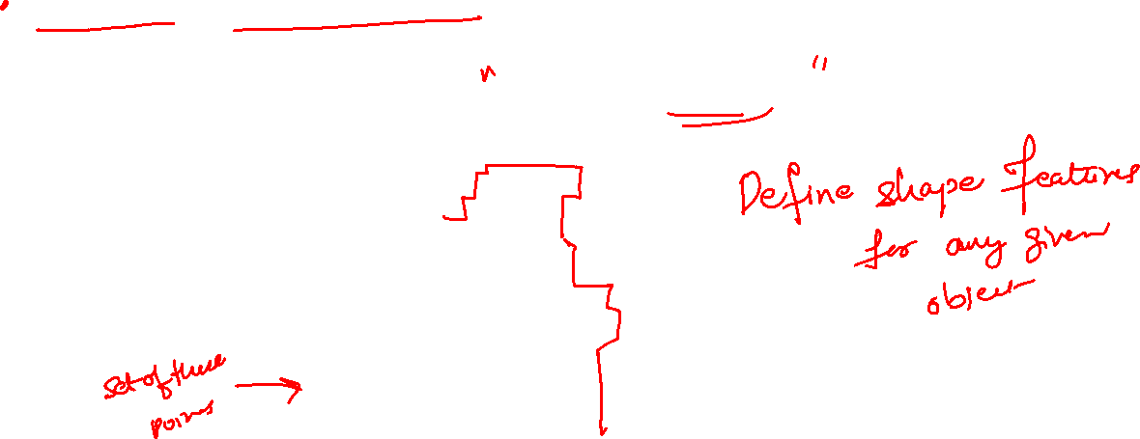
Features from shape
Let the shape of an object be defined as a set of points linked a particular manner

Slide 8
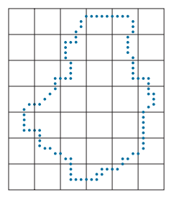

Features from shape
Let us resample the boundary by selecting a larger grid spacing

Slide 9
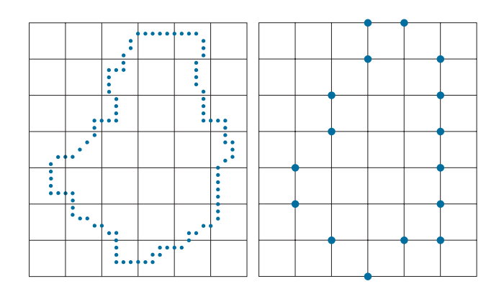
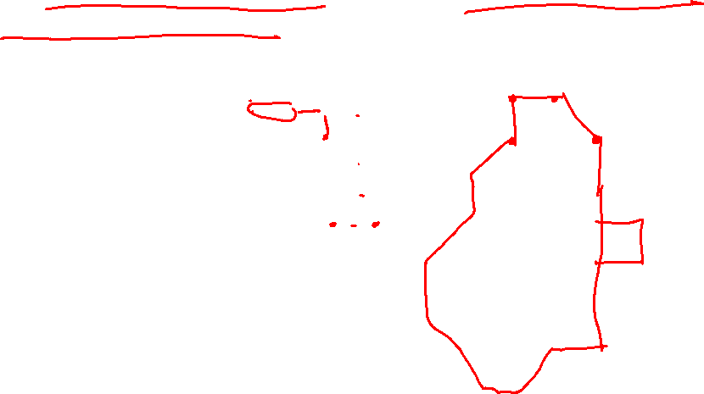
Features from shape
Then, as the boundary is traversed, a boundary point is assigned to a node of the coarser grid, depending on the proximity of the original boundary point to that node

Slide 10
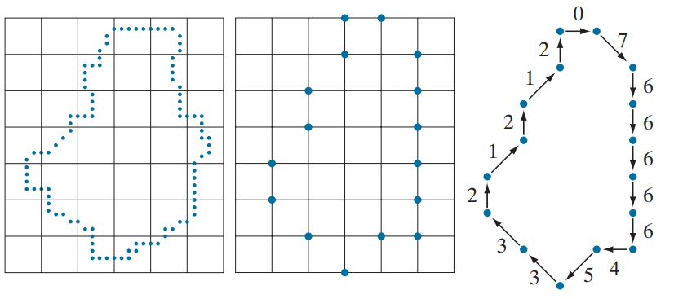
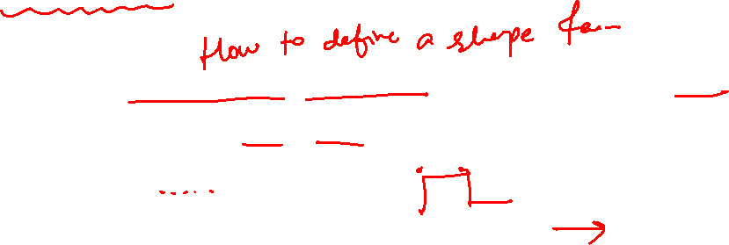
Chain Code Features
Then the resampled boundary obtained in this way can be represented by a 4- or 8-code.

Slide 11

Chain Codes
Chain codes are used to represent a boundary by a connected sequence of straight line segments of specified length and direction.
We assume in this section that all curves are closed, simple curves s (i.e., curves that are closed and not self intersecting).
Typically, a chain code representation is based on 4- or 8-connectivity of the segments.
boundary code formed as a sequence of such directional numbers is referred to as a Freeman chain code.

Slide 12
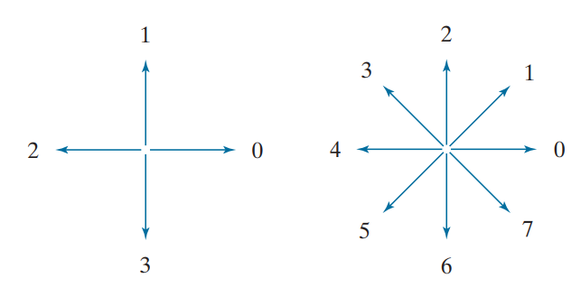
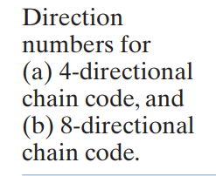
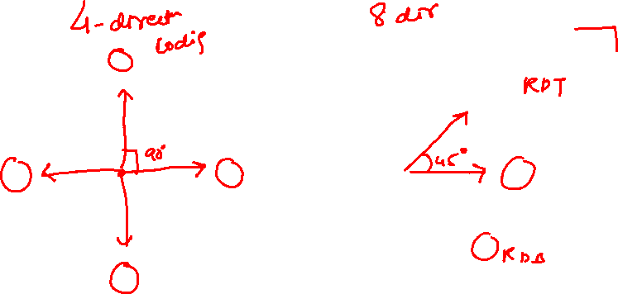
Chain Codes
Typically, a chain code representation is based on 4- or 8-connectivity of the segments.

Slide 13
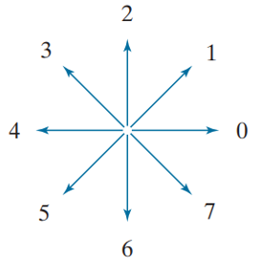
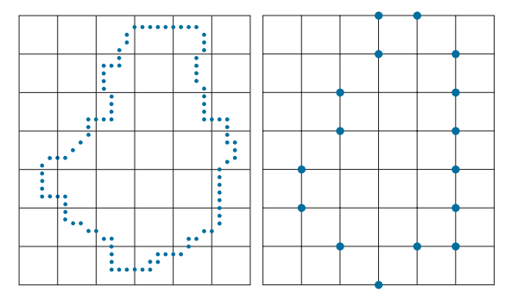
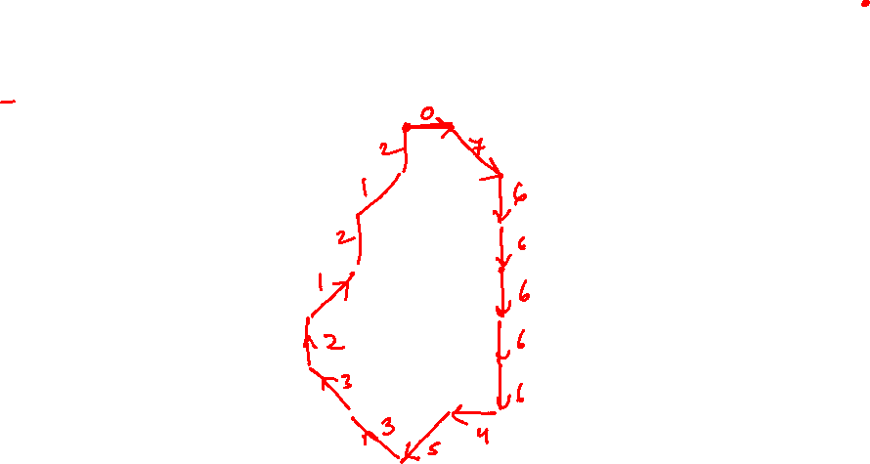

Chain Codes (8 Connectivity)
We fix one starting point and start assigning directions
the spacing of the resampling grid is determined by the application in which the chain code is used.

Slide 14
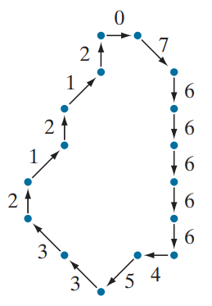
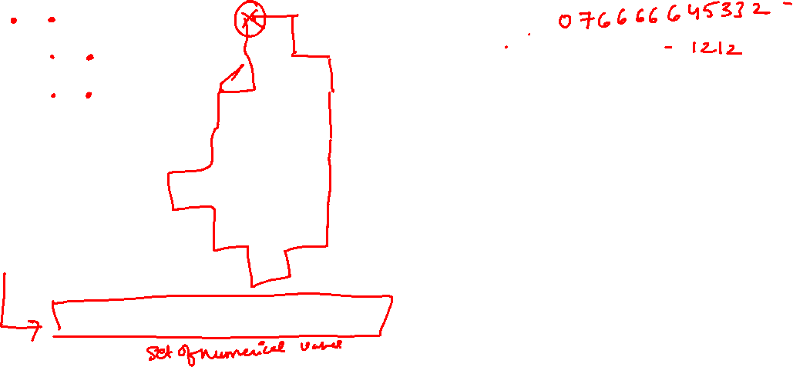
Chain Codes (8 Connectivity)
The numerical value of a chain code depends on the starting point.
chain code 0766666454421212

Slide 15

Chain Codes (8 Connectivity)
The numerical value of a chain code depends on the starting point.
chain code 7666664544212120

Slide 16
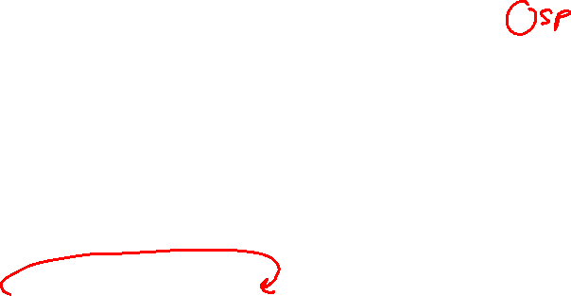
Chain Codes (8 Connectivity)
The numerical value of a chain code depends on the starting point.
chain code 6666645442121207

Slide 17
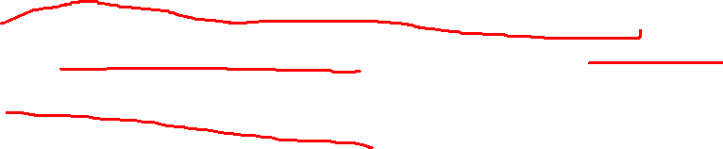
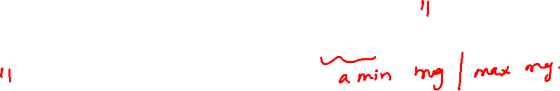
Normalize chain code
The code can be normalized with respect to the starting point by a straightforward procedure:
We simply treat the chain code as a circular sequence of direction numbers and redefine the starting point so that the resulting sequence of numbers forms an integer of minimum/ maximum magnitude.

Slide 18
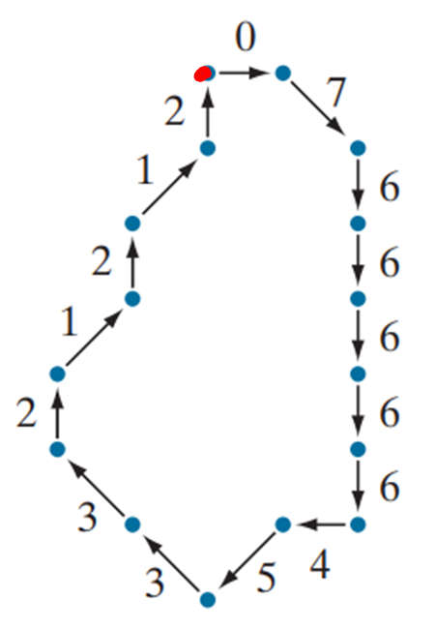
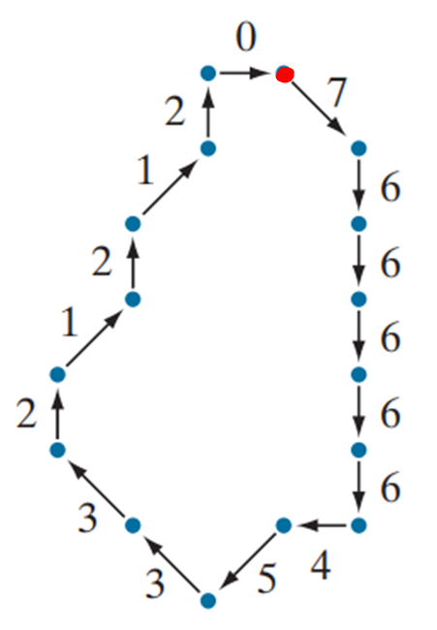
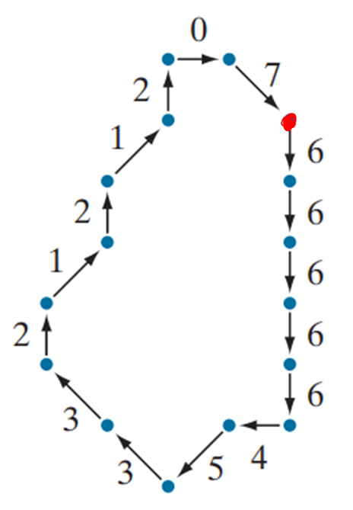
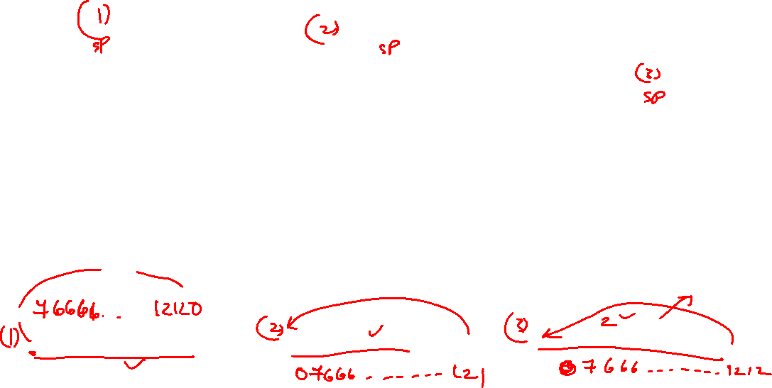
Normalize chain code
Form integer of minimum/ maximum magnitude
0766666454421212
7666664544212120
6666645442121207

Slide 19
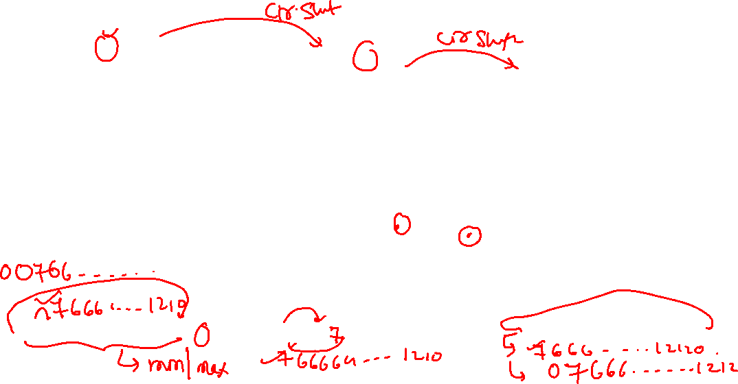
Normalize chain code
Form integer of minimum/ maximum magnitude
0766666454421212
7666664544212120
6666645442121207

Slide 20
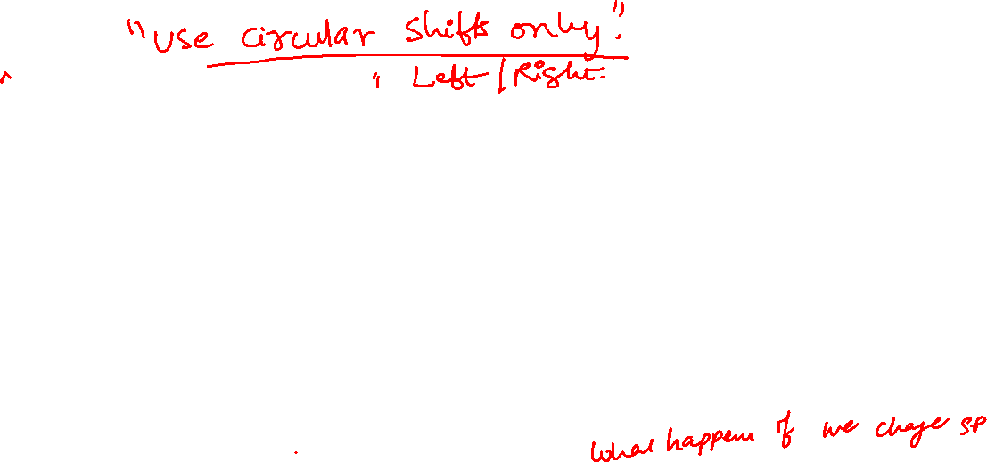
Chain Codes –Invariant to translation
For the same starting point
chain code 7666664544212120

Slide 21

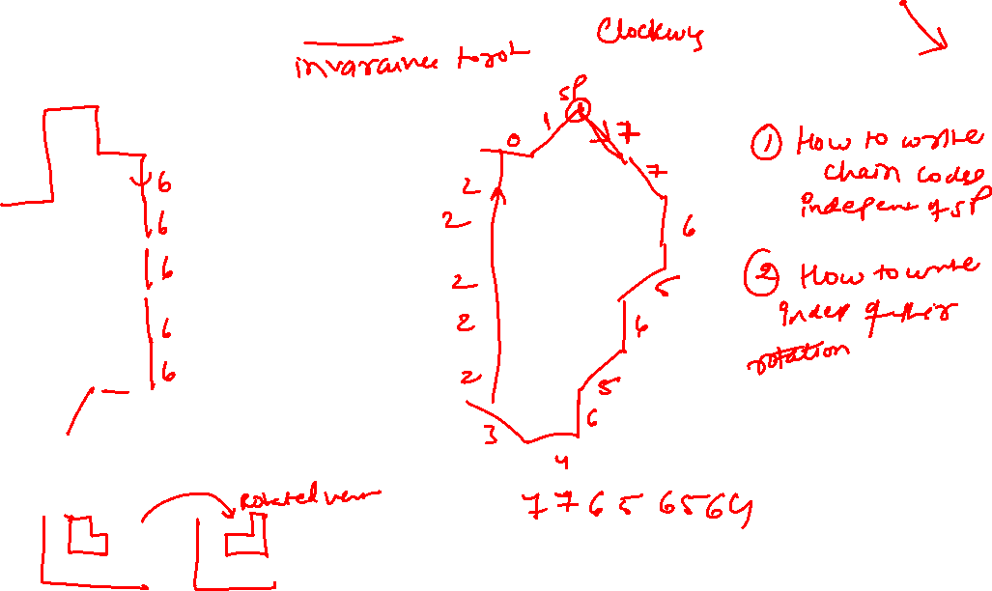
Chain Codes and rotation
chain code 0766666454421212
chain code

Slide 22
Properties
Chain Codes depend upon starting points
Chain Code are not affected by translations provided the starting point is fixed
They change if the object is rotated…
Then how to write a robust feature.

Slide 23

How to write Normalized chain codes?
The code can be normalized with respect to the starting point by a straightforward procedure:
We simply treat the chain code as a circular sequence of direction numbers and redefine the starting point so that the resulting sequence of numbers forms an integer of minimum magnitude.
We can normalize also for rotation (in angles that are integer multiples of the directions) by using the first difference of the chain code instead of the code itself.

Slide 24
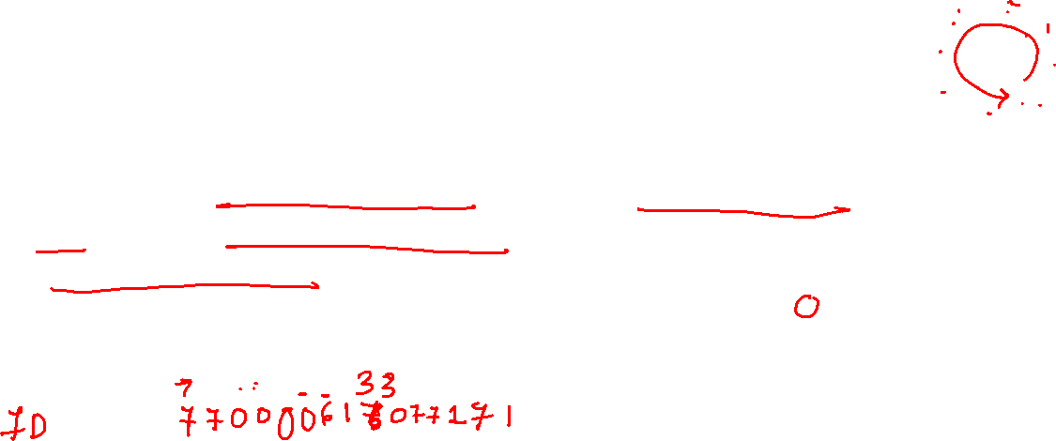
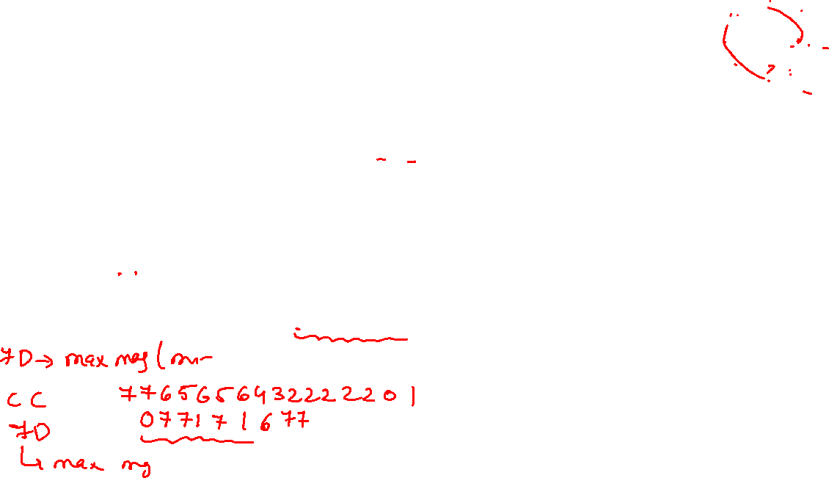
Normalized chain codes
First Difference of chain code:
This difference is obtained by counting the number of direction changes (in a counterclockwise direction) that separate two adjacent elements of the code.
chain code 0 7 6 6 6 6 6 4 5 4 4 2 1 2 1 2

Slide 25

Normalized chain codes
First Difference of chain code:
This difference is obtained by counting the number of direction changes (in a counterclockwise direction) that separate two adjacent elements of the code.
chain code 0 7 6 6 6 6 6 4 5 4 4 2 1 2 1 2
chain code 7 7 0 0 0 0 6 1 7 0 6 7 3 7 1

Slide 26
Normalized chain codes
First Difference of chain code:
This difference is obtained by counting the number of direction changes (in a counterclockwise direction) that separate two adjacent elements of the code.
chain code 0 7 6 6 6 6 6 4 5 4 4 2 1 2 1 2
chain code 6 7 7 0 0 0 0 6 1 7 0 6 7 3 7 1

Slide 27

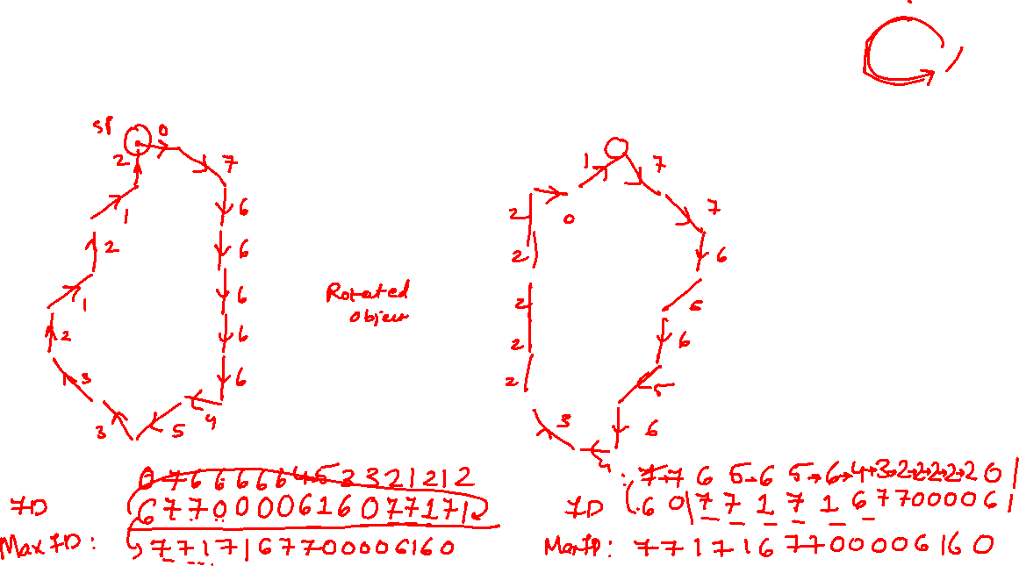
Chain Codes and rotation
chain ccode:
chain code

Slide 29



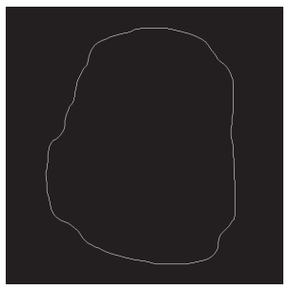


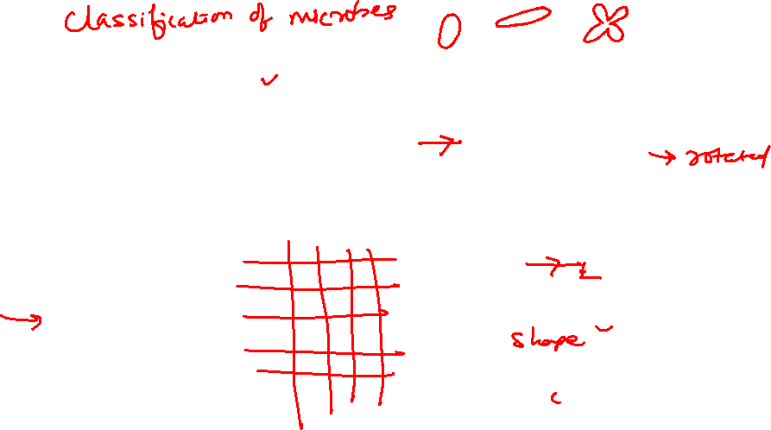
Application of freeman chain code

Slide 30
Application of freeman chain code
Take simplified boundary

Slide 31
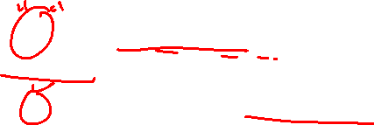
SHAPE NUMBERS
The shape number of a Freeman chain-coded boundary is defined as the first difference of smallest magnitude.
Again rearranged to form smallest magnitude number using circular shift
The order, n, of a shape number is defined as the number of digits in its representation.
Moreover, n is even for a closed boundary, and its value limits the number of possible different shapes

Slide 32
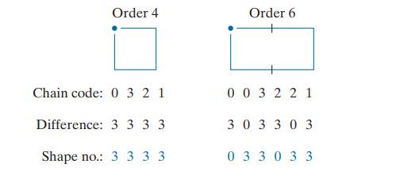
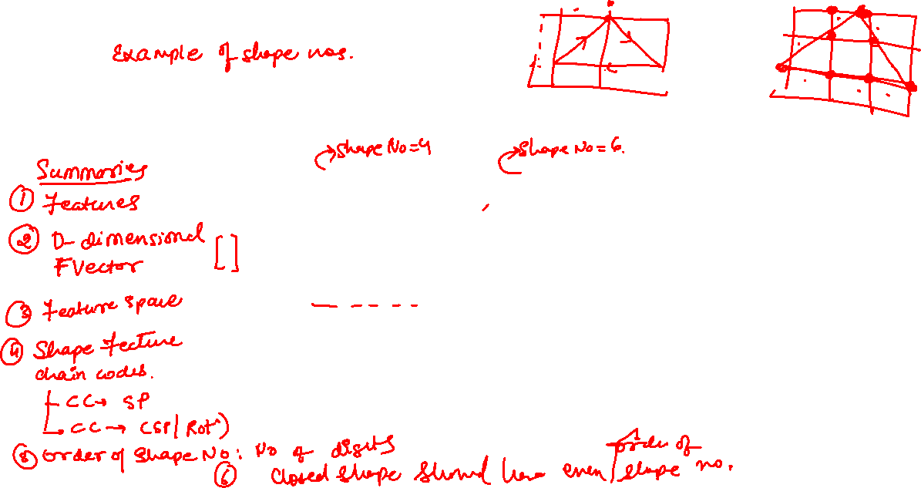

Shape Numbers
Four connectivity

